Slide 1
Alpen Bank
Romania Credit Card Proposal
up201906334, Bruno Rosendo, G14
up201905405, Francisco Colino, G14
up201808549, Isla Cassamo, G14
up201906682, João Mesquita, G14
up201905853, Rui Alves, G14

Slide 2
Table of contents
01
02
03
Alpen’s Business
Alpen Position and Target Segments
Cost of Customer Acquisition
04
05
06
Customers
Breakeven
Should Alpen Launch the Card?

Slide 3

Alpen Business
Alpen Bank is a premium bank that offers basic deposit, checking, and personal loan services.
Customers also have access to a wealth management program composed of financial planning and investment products.
Historically, the company avoided credit card business due to low per-capita income levels, a poorly developed infrastructure of points-of-sale terminals, and the population inexperience with credit.
Image 1. Alpen Bank

Slide 4
Alpen Position and Target Segments
Alpen bank wants to launch a credit card in Romania if it can add €5 million of annual profit to the Consumer Bank segment within two years.
The credit card should be positioned as a premium product and status symbol, with great offers such as higher limit and great benefits.
After a study of the market, it was established that the credit card should be segmented to the socio-demographic middle and upper class that have a high behaviour of conscious buying. 46% of the population with remaining income >= 200€.

Slide 5
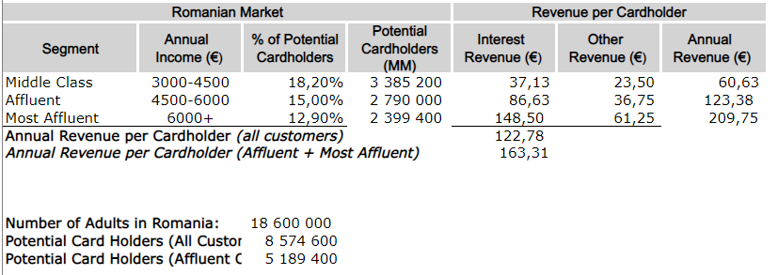
Target Segments and Revenue
Middle Class segment represent 40% of the possible segment targets, while Affluent represents 60%.
The revenue per cardholder when targeting affluent only is significantly higher than when targeting all customers, increasing from 122,78€ to 163,31€.
Table 1. Target Segments and Revenue
Notes:
Analyzing the target segments, we have 3 clear groups: Middle class, affluent and Most affluent. Each segment is characterized by their interest revenue, other revenue and annual revenue, leading to different target ideas for Alpen Bank.
When targeting a middle class, Alpen Bank knows that they provide less revenue, as they can’t afford like the other segments, representing less profit for the company. On the other hand, despite of not being the most significant, they represent a considerable portion of the target segments (around 40%).
On the other hand, Affluent and Most Affluent customers provide more revenue for Alpen Bank and represent 60% of the target segment.
Said this, we can see that targeting all customers, we get around a revenue of 122,78€ per cardholder, and targeting affluent + most affluent we get 163,31€.
To decide which class we should target (if all customers or affluent only), we must take in consideration these revenues per cardholder and the number of potential card holders, which is 3.4 million higher when we are targeting all customers instead of affluent only.

Slide 6
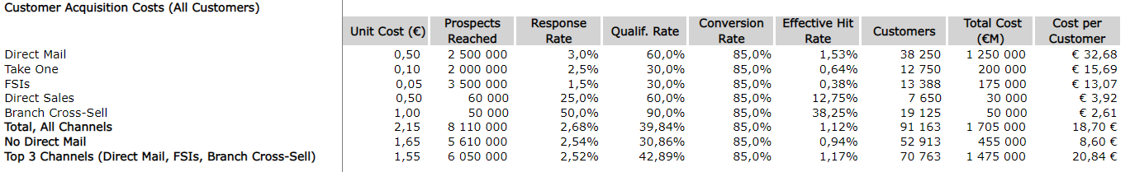
Cost of customer acquisition - All customers
When targeting all customers, the cost per customer highly decreases when no direct mail is used, which is the channel with highest cost per customer.
Using top 3 channels shows to be the most effective technique, but it’s also the most expensive one.
Using Take One and FSIs shows to be less effective due to the percentage of affluent customers in the segment, since middle class only represent around 40% of this segment, but is significantly higher than on affluent only.
Table 2. Customer Acquisition Targeting All Customers
Notes:
The cost of customer acquisition for Alpen Bank's credit card launch in Romania differs depending on the target customer segment. Some factors that influence the cost of customer acquisition are:
Target segment: Alpen Bank has two main target segments for their credit card launch, i.e., all customers or affluent customers only.
Marketing channels: The marketing channels used to reach out to potential customers also impact customer acquisition costs.
Offers and promotions: The cost of customer acquisition is influenced by the type of offers and promotions offered to potential customers. For instance, if Alpen Bank offers a sign-up bonus or rewards program, it may attract more customers but also increase the cost of customer acquisition.
Analyzing the tables in the slide, we clearly see that in the all-customers target, the cost per customer highly decreases when no direct mail is used since it’s the most expensive.
On the other hand, using just the top 3 channels shows to be the most expensive technique.

Slide 7
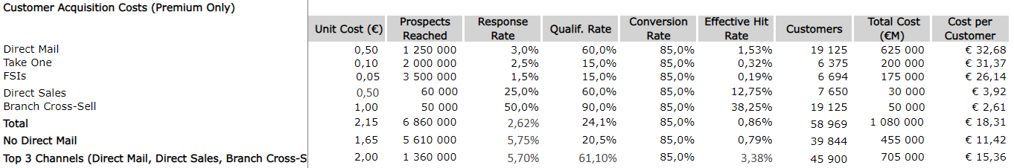
Cost of customer acquisition - Affluent-only
Not using direct mail also decreases the cost per customer, but using the top 3 channels shows to be cheaper than using all the channels, but it reaches a very limited number of prospect.
Decrease in the number of customers in all the channels, comparatively to all customers segment.
Using Take One and FSI in this segment shows a very low effective rate, because affluent customers have higher expectations for the quality and relevance of promotional material they receive. We also see that the cost per customer using those channels doubles comparatively to all customers segment.
Table 3. Customer Acquisition Targeting Only Affluent
Notes:
On the affluent customers only, we also see the pattern that not using direct mail decreases the cost per customer, but when using the top 3 channels shows to be cheaper than using all the channels, but it reaches a very limited number of prospects.
We also see a significant difference in the number of customers targeted, going from 91163 to 58969 using all channels, from 52913 to 39844 not using direct mail, and from 70763 to 45900
Using just the top 3 channels in each segment target. Further analysis is done in the next slides so we can decide which segment we should target and the channels we should use to reach that segment.
As said in the previous slide, using offers and promotions may increase customer costs, which can be seen in the tables. Using Take One and FSI channels, which are promotional channels, we see that the cost per customer doubles when we are targeting the affluent only. This may be because affluent customers have higher expectations for the quality and relevance of promotional materials they receive, and requires a more targeted and personalized approach. This is consistent with the data, where we can see that the effective hit rate using Take One is about 0.32% and using FSI is around 0.19%, being the other channels the most effective ones (with special attention to Direct Sales with 12.75% and Branch cross. sell with 38.25%), and with a lower cost per customer (3.92€ using Direct sales and 2.61€ using Branch Cross-Sell)

Slide 8
Customer Economics
Romanian Market |  |  |  | Revenue p/ card holder
Segment | Annual income (€) | % potential cardholders | Potential cardholders | Interest revenue (€) | Other revenue (€) | Annual revenue (€)
Middle class | 3000-4500 | 18,20% | 3 385 200 | 37,13 | 23,50 | 60,63
Affluent | 4500-6000 | 15,00% | 2 790 000 | 86,63 | 36,75 | 123,38
Most affluent | 6000+ | 12,90% | 2 399 400 | 148,50 | 61,25 | 209,75
Table 4. Economics of Different Customers
Notes:
Alpen Bank wants to target customers with at least 3000€ annual income (the threshold for the middle class) since lower classes are historically uninterested in credit cards and usually don’t have the funds to give the bank profit. That said, we can separate the customers’ economics into 3 segments.
We can see that, while the middle class holds a large number of potential customers, the annual revenue per cardholder is much smaller compared to the affluent segment. On the other hand, the most affluent class has a large annual revenue and a smaller number of potential cardholders.
By defining 2 segments (all customers and only affluent), we can analyze different situations with the goal of discovering the best solution to reach the target of 5M€ annual profit in two years (if possible). In order to know if the business is profitable at all, we should first start by calculating the number of customers for breakeven.

Slide 9
Break-even Number of Customers
BreakEven = (FixedCosts - FixedRevenue) / UnitaryRevenueMargin
Segment\Marketing | All Channels | No Direct Mail | Top 3 Channels
All Customers | 78 719 customers | 75 717 customers | 79 445 customers
Only Affluent | 53 602 customers | 53 417 customers | 53 521 customers
Table 5. Break-even Number of Customers
Notes:
BE = (Fixed Cost - Fixed revenue) / Unitary Revenue Margin (custo de novo cliente)
For the breakeven calculations, we considered situations combining one of the 2 segments considered (all customers or only affluent) with one of the 3 marketing strategies (all channels, no direct mail, and top 3 channels). The results were:
All Customers
All Channels: 78 719 customers.
No Direct Mail: 75 717 customers.
Top 3 Channels: 79 445 customers.
Only Affluent
All Channels: 53 602 customers.
No Direct Mail: 53 417 customers.
Top 3 Channels: 53 521 customers.

Slide 10
Number of Customers for 5M€ Annual Profit
Calculated using a similar approach as the break-even point, but with a base amount of 5 million instead of zero.
Segment\Marketing | All Channels | No Direct Mail | Top 3 Channels
All Customers | 130 565 customers | 127 451 customers | 131 316 customers
Only Affluent | 92 816 customers | 90 621 customers | 91 848 customers
Table 6. Number of Customers for 5M€ Profit
Notes:
Number of Customers = (Fixed Cost - Fixed revenue + 5 000 000) / Unitary Revenue Margin (custo de novo cliente)
With a similar approach as the breakeven, we can calculate the number of customers needed to achieve an annual profit of 5M€:
All Customers
All Channels: 130 565 customers.
No Direct Mail: 127 451 customers.
Top 3 Channels: 131 316 customers.
Only Affluent
All Channels: 92 816 customers.
No Direct Mail: 90 621 customers.
Top 3 Channels: 91 848 customers.

Slide 11
Is Break-even Achievable?
Yes, break-even is achievable in all the analyzed scenarios, in varying time frames.
Faster combinations are (All customers; All channels) and (Affluent-only; All channels).
Used the customer acquisition data from the case to calculate the rate of customer acquisition for every scenario.
Marketing Strategy / Customer Segment | All Channels | No Direct Mail | Top 3
All Customers | 10,4 / 17,2 (months) | 17,2 / 28,9 (months) | 13,5 / 22,3 (months)
Affluent-only | 10,9 / 18,3 (months) | 16,1 / 27,2 (months) | 14,0 / 23,5 (months)
Table 7. Months to reach Break-Even / 5M Profit
Notes:
Yes, break-even is achievable in all the analyzed scenarios, i.e for both customer segments (all customers or affluent-only) and using any marketing strategy (All channels, no Direct Mail, and Top 3). However, the time period in which both break-even and 5M profit are achieved varies according to these 2 variables as depicted below:
As we can see, breakeven is achieved faster with the combination (All Customers, All Channels) in only 10,4 months, followed by the combination (Affluent-only, All Channels).
Note that for this calculation, we used the customer acquisition data present in the Case. Therefore, we calculated the rate of customer acquisition for each combination of marketing strategy and customer segmentation to reach a better approximation. However, the result is not flawless since it’s based on an estimate for the first year of the credit card launch.
Regarding Customer Segmentation, it’s not clear which choice is better for Alpen Bank and it will be explored in greater detail in the next question. Nonetheless, it’s worth noting that targeting all customers leads to more revenue since there’s more customer growth. On the other hand, this segmentation has a smaller profit margin so the cumulative profit is not that different from the other segmentation alternative.

Slide 12
Best Marketing Strategy
The most profitable is using All Channels.
The customer acquisition cost is at least 1 order of magnitude lower than the yearly revenue generated from each customer. Thus, aiming for a strategy that reaches more customers, although with a lower hit rate, will provide more profit to the company.
Marketing Strategy / Customer Segment | All Channels | No Direct Mail | Top 3
All Customers | 10,4 / 17,2 (months) | 17,2 / 28,9 (months) | 13,5 / 22,3 (months)
Affluent-only | 10,9 / 18,3 (months) | 16,1 / 27,2 (months) | 14,0 / 23,5 (months)
Table 7. Months to reach Break-Even / 5M Profit
Notes:
So, we can conclude that the most profitable marketing strategy is using all channels. This makes sense since according to our data, the customer acquisition cost (18,7/18,31€) is one order of magnitude lower than the yearly revenue generated from each customer (122,78/163,31€). Thus, aiming for a marketing strategy that reaches more customers, although the hit rate might be lower, will provide more profit to the company in the long term.

Slide 13
Should Alpen launch the credit card ?
YES. Alpen should launch the credit card.
Break-even is achievable as shown before.
2 out of the 3 strategies proved to comply with the requirement of 5M profit in 24 months.
Marketing Strategy / Customer Segment | All Channels | No Direct Mail | Top 3
All Customers | 10,4 / 17,2 (months) | 17,2 / 28,9 (months) | 13,5 / 22,3 (months)
Affluent-only | 10,9 / 18,3 (months) | 16,1 / 27,2 (months) | 14,0 / 23,5 (months)
Table 7. Months to reach Break-Even / 5M Profit
Notes:
Yes, Alpen should launch the credit. For the launch of the card to be viable in reality only one of the strategies paired with one of the target segments needed to complete the requirement, however 2 of the strategies, paired with either of the target segments, show they are compatible with the requirement, with the strategy of No Direct Mail being the only one that fails with both target Segments

Slide 14
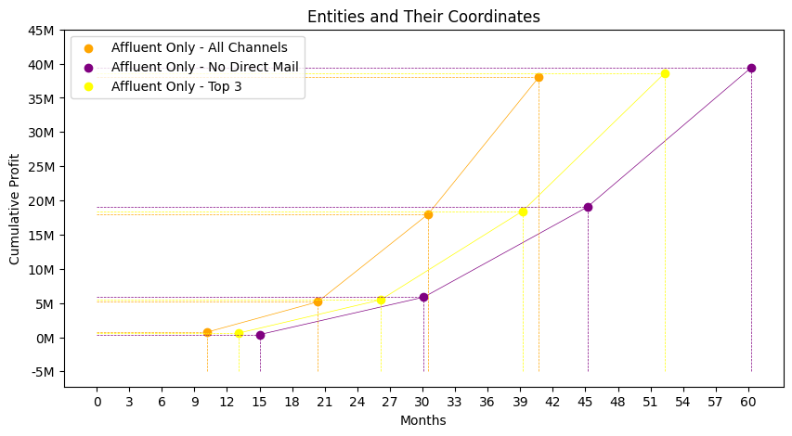
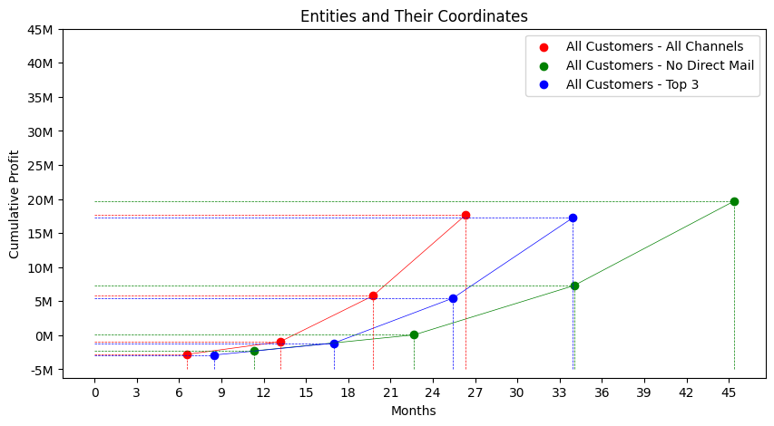
Which marketing
strategy?
No Direct Mail is the only strategy that fails the requirement - Not viable.
All Channels achieves breakeven 3 months sooner than top 3.
All Channels hits the 5 million profit mark 5 months sooner than top 3.
All Channels proves to be the best strategy, independently of the targeted segment.
Image 2. Marketing Strategies
Notes:
The all Channels proved to be the most successful strategy with a projected breakage of breakeven in less 3 months than the 2nd best strategy and 5 months sooner for the 5M profit requirement.
It leaves no doubt that the strategy to go with is the All Channel Strategy independently of the target segment that is chosen.
No Direct Mail proved to be the worst strategy, although being more expensive than the other methods, it shows to be more effective and ultimately worth the heavy price tag.

Slide 15
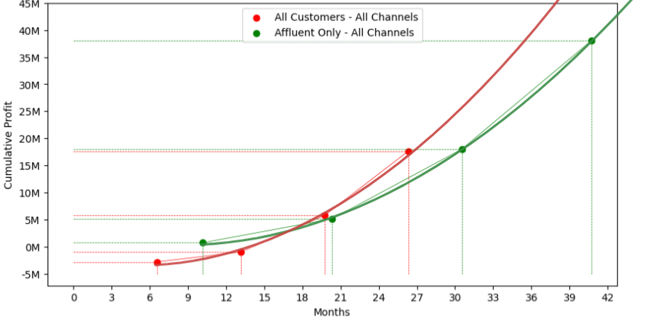
To which target segment
Choice not as clear as the marketing strategy.
Initially bigger loss for the All customers strategy.
All customers has a faster growth in cumulative Profit over time.
All Customers segment needs 200k customers in order to compete with Affluent Only with only 150k, 25% more customers.
Middle class shows a decreasing trend as income inequality increases.
Image 3. Customer Segments
Notes:
Contrary to the marketing strategy, what target segment to choose is not absolutely clear since there are a few different advantages and disadvantages that each part of the spectrum present.
If All Customers were chosen then, although the first 50k will generate a lot more loss, the growth trend shows more potential and, when considering a time-frame, it reaches a higher profit when compared to Affluent-Only.
However this is not the case when comparing the number of customers, the All Customers segment needs 200k customers in order to achieve the same profit as the affluent segment with only 150k.
This is an important factor since the number of customers is not only ultimately limited as the middle class is losing ground to the Affluent.
So if the number of All Customers were to considerably outnumber the affluent prospects then, All Customers would be the wiser choice, with the current data and path that the population is headed, Affluent-Only proves to be the better choice.
Another important note is that keeping the Affluent-Only aspect also follows with Company’s premium image, which works into appealing the project to Zurich HQ.

Slide 16
To which target segment
Which is better?
All customers would be better if the middle class was more dominant.
This is the case since it presents a considerable faster profit growth rate, even though 5M profit margin is hit at almost the same time.
However:
High customer count requirement to compete with Affluent Only.
Middle class will decrease, affluent segment will gain more dominance.
With the gap of the number of possible customers between target segments decreasing, All Customers loses its biggest edge over Affluent Only since it’s highly dependent on their higher number of customers.
Notes:
All Customers
Faster Profit (due to higher customer acquisition rate)
Seen in other emerging markets that credit cards tend to be “stickier” – less likely to switch, so the competition may difficult customer acquisition.
Customer acquisition is limited
Affluent-Only
Higher Profit Potential
Follows the Company’s premium image, which is a worry for the Zurich HQ.
Income inequality is increasing (the middle class is decreasing)
Less amount of applicable customers
Takes more time to achieve high profitability

Slide 17
To which target segment - Conclusion
Marketing strategy: All Channels Target segment: Affluent Only
Sacrificing a possibly faster profit growth rate for safety.
Breaking even with 35k less customers, but later in the time-frame.
Still hitting the 5M mark almost 6 months before the deadline.
Bonus:
Maintains the Company’s prestige status which might be more appealing to Zurich’s HQ.
With income inequality the profit growth rate might accelerate even further.

